Slide 1
Reproducing the Classic Calculator Using Modern Web Technology
Takahiro FUJIWARA DQ4WX0, 7th Semester Faculty of informatics, Computer Science Engineering
University of Dunaújváros Supervisor: Dr. Király Zoltán, Tetsuo Iwase
Notes:
[00:00-00:13] len=00:13
Hello,
My name is Takahiro Fujiwara,
I would like to introduce my project
“Reproducing the Classic Calculator,
Using modern web technology.”

Slide 2


Introduction
We are familiar to Calculator
Use it in real life, shopping, study, business
Computer Science Students learn programming of calculator.
Calculator H/W is decreasing…
Go in the PC, now go in Smartphone
Calculator may disappear like analog phones.
Modern people will be interested in classic calculators.
Like classic cars.
Photo
Display
Sound
Touch Feeling
Unique Operation
The Goal Is to Provide Realistic Simulation With the World’s First Calculator
Notes:
[00:15-00:44] len=00:29
Introduction,
We are familiar to calculator, [[ Especially we, computer science students. ]]
Recently, we can use it on PC software, Or, on the Smartphones.
That means the dedicated hardware might be disappear like analog phones.
Finally, modern people will be interested in classic calculators, Like classic cars.
The Goal is to provide a realistic simulation

Slide 3
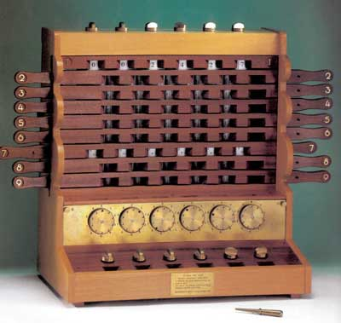
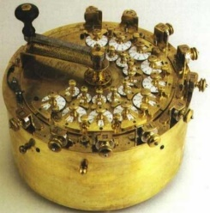
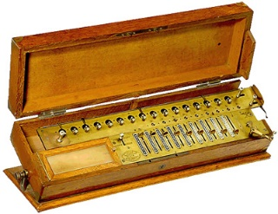

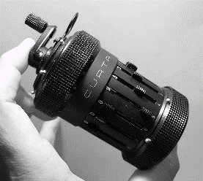
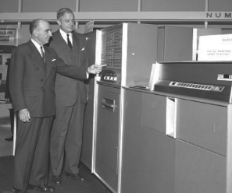
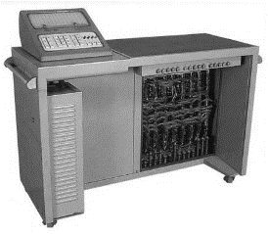
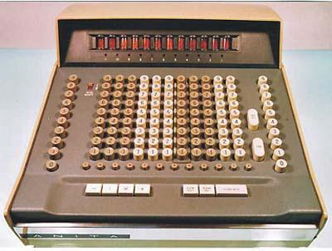
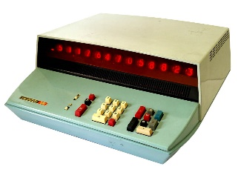
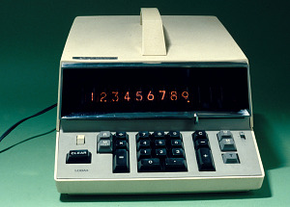
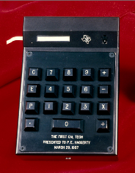
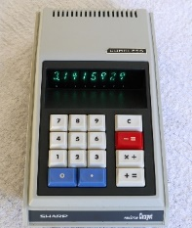
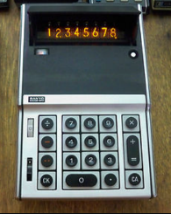
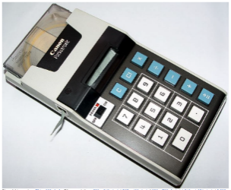
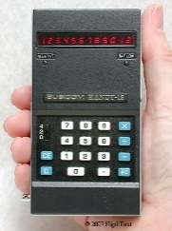
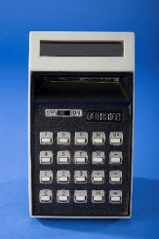
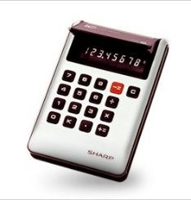
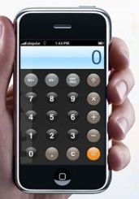
History of World’s First Calculator Focused on Handheld, Display Technology
According to:
EdTechMagazine.com
VintageCalculators.com
TheCalculatorSite.com
arithmomuseum.com
W-First: World’s First
1623: W-First Adding Machine (DE)
<photo: replica>
1773: W-First Functional Calculator (DE)
1820: W-First Commercially Produced Mechanical Calculator (FR)
1945: W-First Vacuum Computer ENIAC (US)
1948: W-First Pocket Calculator CURTA (AU)
1954: W-First All- Transistor Calculator 608 by IBM (US)
1957: W-First All-Electronic Dedicated Calculator 14-A by CASIO (JP)
1961: W-First All-Electronic Desktop Calculator ANITA-VII by Bell Punch (UK)
1964: First Hungarian Desktop Calculator HUNOR 131 by EMG (HU)
1600
1650
1700
1750
1800
1850
1900
1950
1960
1970
1980
1990
2000
2010
2020
1960
1967: W-First portable battery-operated calculator ICC-500W by SONY (JP). Nixie display
1967: W-First prototype handheld ‘Cal-Tech’ by Texas Instruments (US). Output: Paper-tape only.
1970: W-First mass-produced handheld battery calculator QT-8B by SHARP (JP). VFD display.
1970: W-First Handheld Nixie display Calculator, ICC-82D by SANYO (JP) Nixie display.
1970 W-First Handheld Printing Calculator, Pocketronic by Canon (JP), Contribution by Texas Instruments (US) Paper-Tape only.
1971: W-First Handheld LED display, LE-120A by Busicom (JP).
Segment LED.
1973: W-First LCD Display, LC-800 by DATAKING (US).
Segment LCD
1973: W-First mass-produced LCD Display, EL-805 by SHARP (JP).
Segment LCD
2007: W-First touchscreen smartphone with calculator, iPhone by Apple (US). Pixel LCD, color.
Notes:
[00:46-02:21] len=01:35
At the beginning,
I checked the World’s first Calculators
The origin of the Calculator and the Computer is the same,
So, I will skip these old era.HP
[ENTER] The first electronic dedicated calculator is made by CASIO, Japan.
[[ It is a desk style calculator, Whole desk body is the calculator itself. ]]
[ENTER] This is the first desktop calculator. [[ ANITA-7 by Bell Punch,]] UK.
[ENTER] And here, this is not a world first,
But First Hungarian Calculator, [[ Just 3 years later than ANITA-7. ]]
[ENTER] More 6 [[3]] years later,
The Firs portable calculator was released.
Portable means bring it by hand. By SONY, Japan.
[ENTER] In the same year, the prototype of
First handheld calculator is shown. Finally, not released.
[ENTER] And 3 years later.
First handheld calculator is released By SHARP, Japan.
[[ [ENTER] And there are some first handheld.
Like, first nixie display, first print model, first led, first lcd…
[ENTER] Finally, First touchscreen calculator on smartphone. ]]
Now, I decided to focus on first handheld calculator.
not prototype one,,
[ENTER] It is SHARP QT-8B, this.

Slide 4
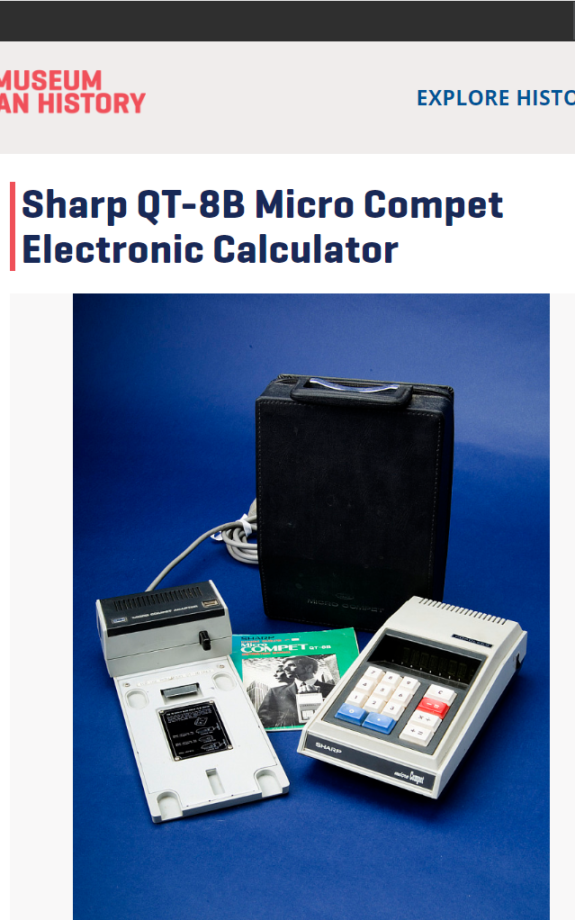

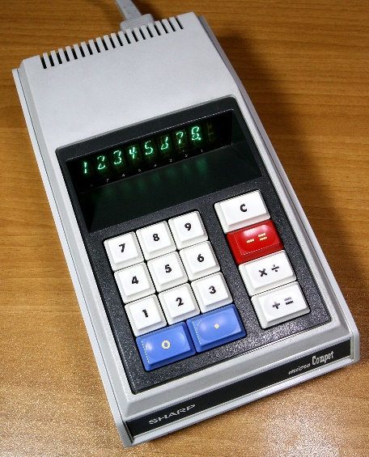
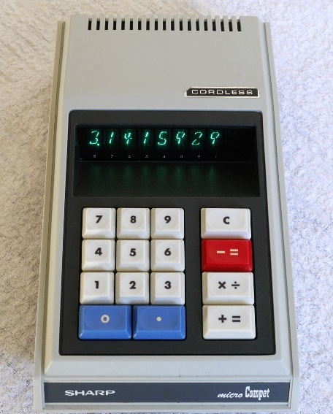
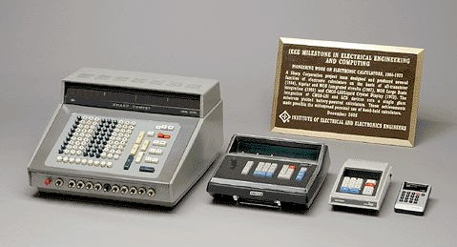
Why Focused on Sharp QT-8B? From Many of the World’s First.
One of collection at Smithsonian Museum, USA
Archiving the “Creativity and Innovation Things” ➔
SHARP received IEEE Milestone, includes QT-8D (predecessor of QT-8B) ⬇
QT-8D, 1969
AC Powered
QT-8B, 1970 Battery Powered
SHARP IEEE Milestone Calculators, 1964-1973
“Honor Historical Achievements”
Notes:
[02:23-02:53] len=00:30
Why QT-8B, the reason is:
It is one of collection at Smithsonian Museum in USA.
They are archiving the “Creativity and Innovation Things”.
And One more,
They received IEEE Milestone, like a prize.
By the predecessor model, which is not handheld because
It can not operate by battery.
and they replaced the power module to battery in next year,
it is the world’s first handheld, QT-8B

Slide 5
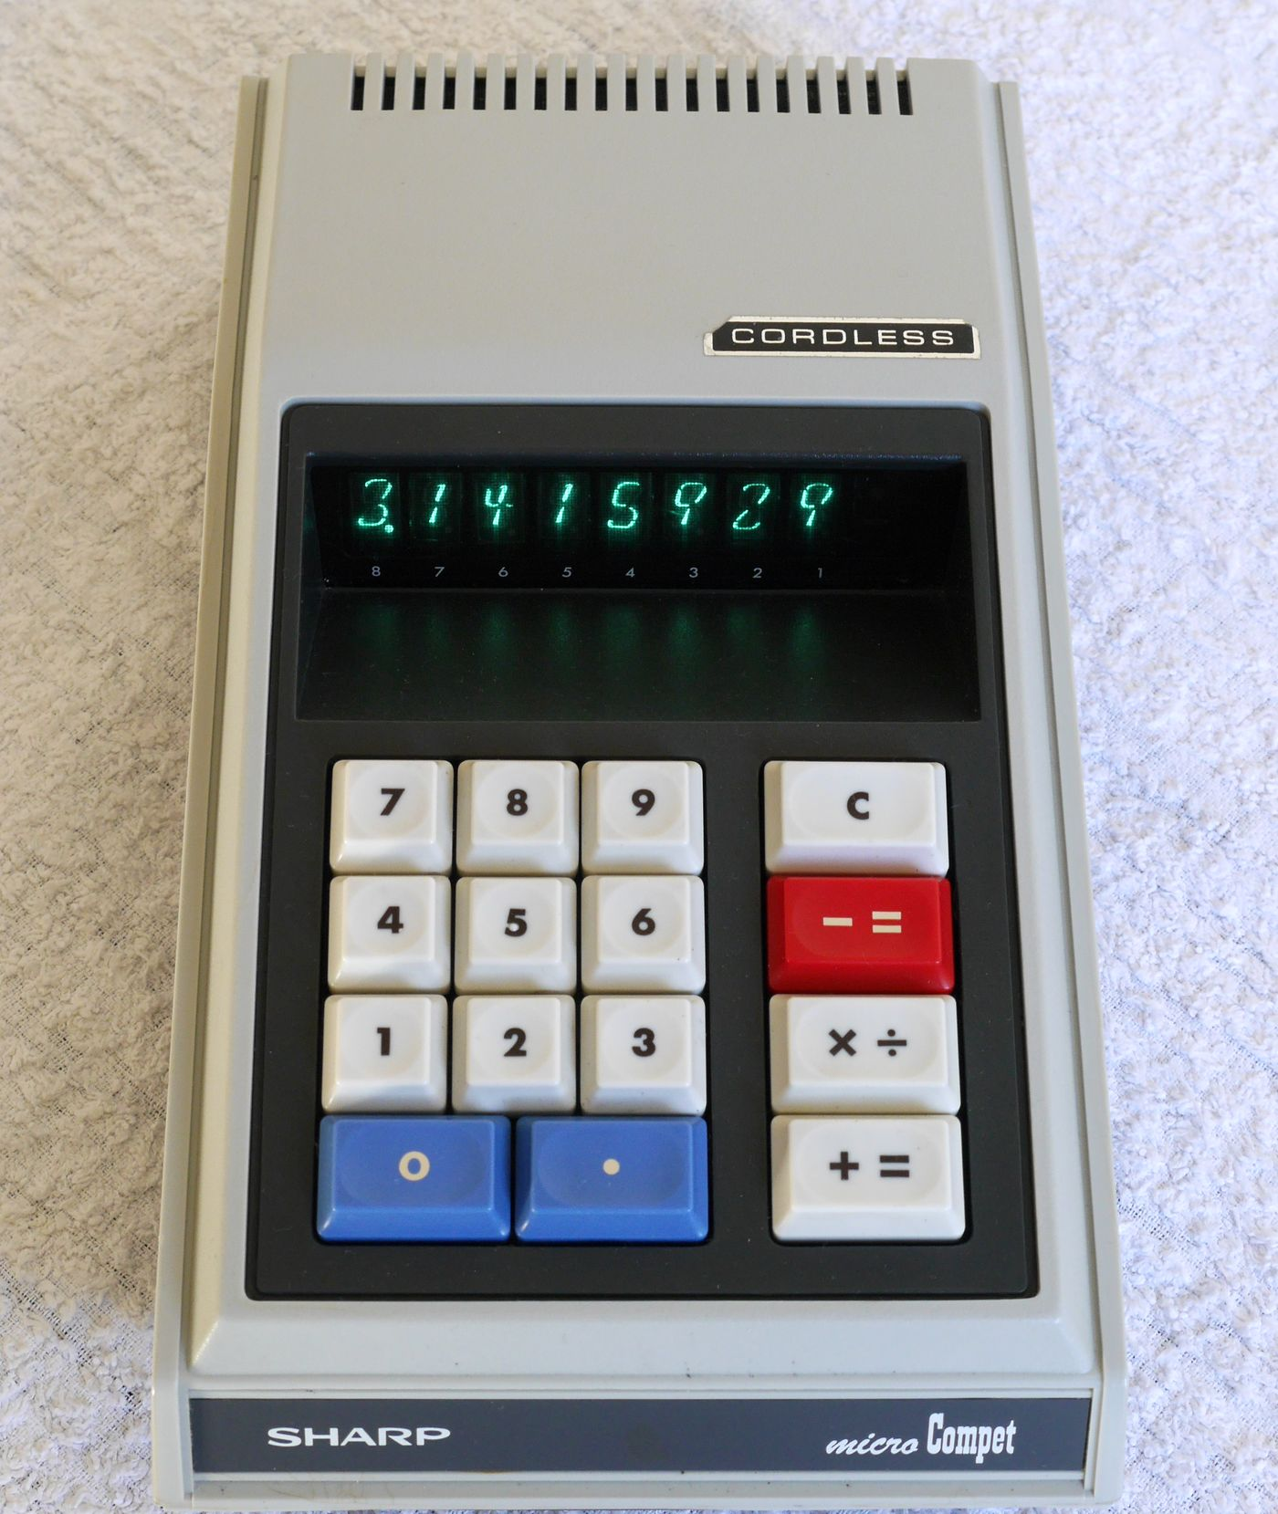
Let’s Go Back to 1970 Simulation Points and Direction
Use a real photograph
3D perspective
Simulate the display, look and feel
VFD segment display
Simulate the old era operations
Very unique combination key
Simulate the feel of the buttons
Mechanical sound, Button touch
Direction: simulate it …
On a web page for people to experience
•
•
•
•
NEXT
Notes:
[02:55-03:25] len=00:30
Let’s go back to 1970.
These are the simulation points
First, I decided to use a real photo.
This is the base of my idea.
Second, simulate the old era display
Third, the old era operation.
[[ You can see, It has different buttons. ]]
And next, simulate the feel of the buttons
Finally, simulate it with modern technologies.
Let’s check it one by one.

Slide 6
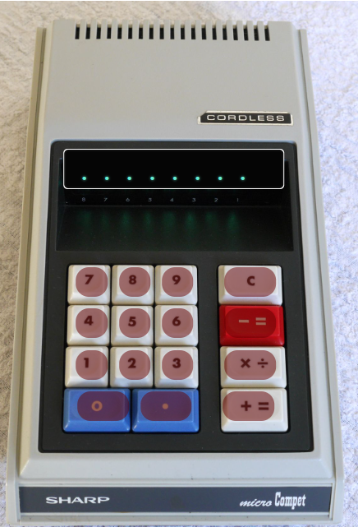
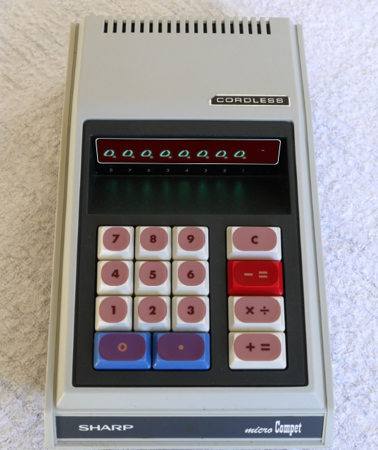
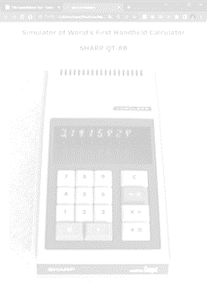
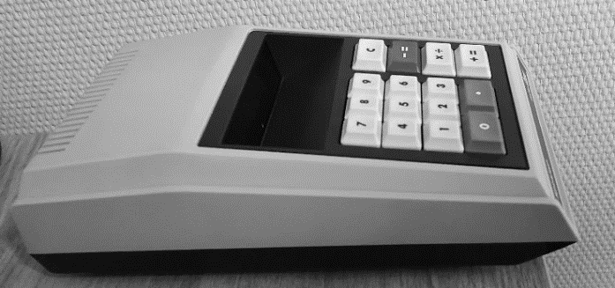
[1] Use a Real Photograph
Got acceptance to use it from owner of photo, QT-8B
Perspective is adapted
Display, buttons on the photo
Transformed a rectangle into a trapezoid
Just put the objects
Perspective is adapted
Technology: CSS Transforms Module Level 1 (2019 candidate Recommendation)
Notes:
[03:27-03:47] len=00:20
This explains using a real photo.
I got an acceptance to use it from QT-8B Owner.
Display and buttons are placed on the phot.
Needed to transform a rectangle into a trapezoid

Slide 7
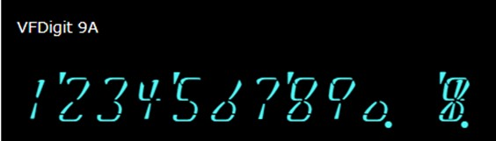
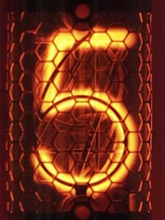
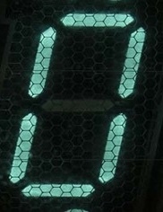
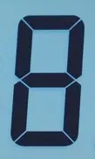

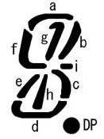
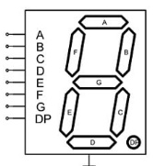


[2] Simulate the Display Look and Feel
VFD segment display and special design was used
Same design font is available since 2021, by individual
I used it with web-font technology
To show it for all audience
⬇QT-8B, 1970
SIL Open Font License
https://github.com/jz5/fonts-vfdigit
>
>
Sample Photo and Power Consumption
Technology Name | NIXIE (Numeric Indicator experiment No.1) | VFD (Vacuum Fluorescent Display) | LCD (Liquid Cristal Display)
Main-stream | 1950-1970s | 1967-1980s | 1973-now
a
Local Font
HTML
CSS
Aa
Internet
JavaScript
QT-8B has 9 segment
Recent design 7 segment
Web Font
Web Server
a
Local Font
Aa
Popular Technology Since 2010
Notes:
[03:49-04:16] len=00:27
Second, I need to simulate the display
But the design is very unique segment display.
[[ Segment display is showing left-blow. ]]
Fortunately, I can use this design as a font.
And applied the web-font technology for it.
[ENTER]
Usual font is a local font
[ENTER]
In case of Web font, everyone can see the same design.

Slide 8
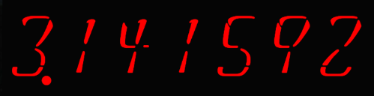

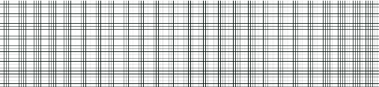

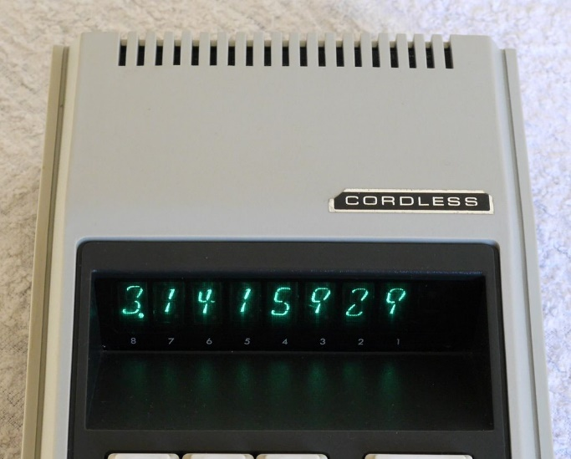



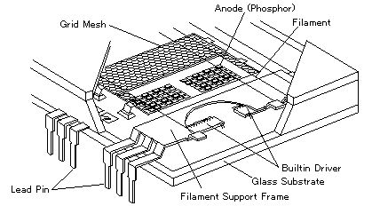


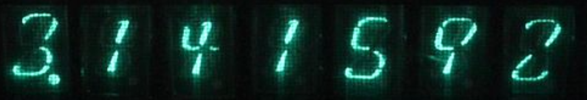
The Road to Simulation for Display
1. | Font is adapted
2. | Letter space is adjusted
3. | Transform perspective is adapted
4. | Overlay on the real photo
5. | Color is adjusted
6. | Illuminated by shadow attribute
7. | Mesh on the text
8. | Real photo
Ingenuity Point
Made a layered display on HTML
Technology
CSS Text Decoration Module Level 3 (2019 candidate Recommendation), transport, …
Covered by Mesh
Number display
.
Dot print area
Background
VFDs also have mesh
USING
Notes:
[04:18-04:54] len=00:36
Here shows the road to simulation for display
You can see,
1st, font is adapted.
2nd, letter space,
3rd, perspective,
4th, overlay on the real photo
5th, color is picked from a photo
6th, blurry, illuminated by shadow attribute
7th, mesh on the text,
And check it with photo, always.
To achieve this, I made a layered display on HTML., 4 layers.

Slide 9
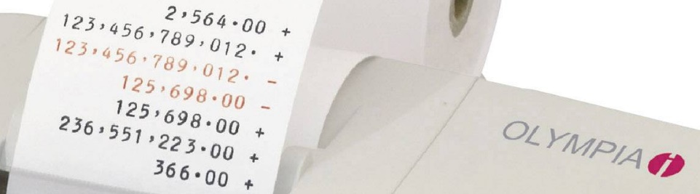
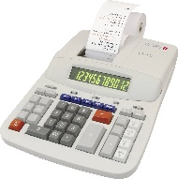
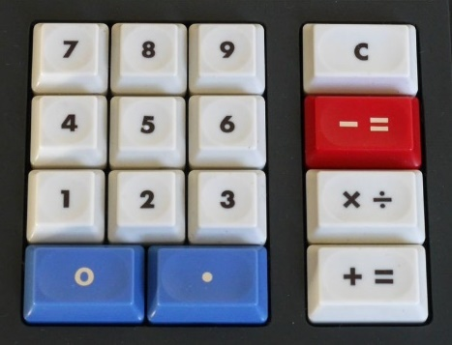
[3] Simulate the Old Era Operations
Seems influenced from cash register operation
Expression-based input wasn’t settled in old time
Cf. SONY calculator followed expression-based input in 1964, got “amazing” but it was done as prototype.
 |  | QT-8B |  |  | Regular Calc.
 | Action | Operation | Display |  | Operation | Display
1 | Purchase $10 | 10[+=] | 10. |  | 10[+] | 10.
2 | Purchase $20 | 2[+=] | 12. |  | 2[+] | 12.
3 | It was TYPO! | 2[−=] | 10. |  | [−]2[+] | 10.
4 | Re-enter | 20[+=] | 30. |  | 20[+] | 30.
5 | Give $100 | 100[−=] | 70. − |  | [−]100[=] | 70. −
6 | Back $70 |  |  |  | 2 more keys
modern calc.
The Work What I Did
Check the Instruction Manual
Check the real behavior QT-8B/8D especially, division
QT-8B Keys
Notes:
[04:56-05:26] len=00:30
Next, simulate the old era operations.
[[ As you can see, there are no independent keys
For plus, minus, multiply, divide. ]]
It seems this is influenced by cash register operation.
If you buy something and pay money,
Cash register operation is optimized.
See this table, regular calculator needs 2 more keys.
[[ I had to read the instruction manual
and check it with the real machine. ]]

Slide 10
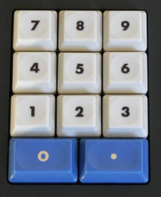
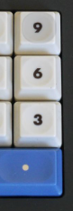
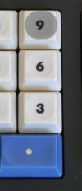
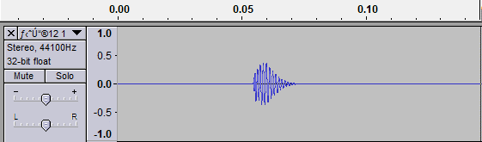
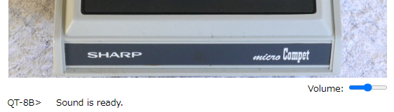
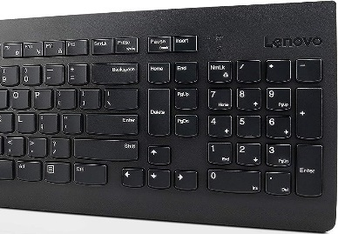
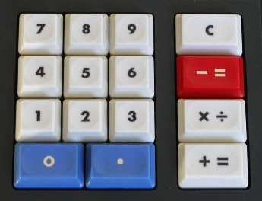

[4] Simulate the Feel of the Buttons
Need mechanical sound
Just record it and make sound editing as short
Play sound when press the key
Simulate the feeling of touch
Imitate the shadow of a finger
PC keyboard also available
Idle state
Point on “9”
Press “9”
PC Keyboard
QT-8B Keys
Notes:
[05:28-05:37] len=00:09
Next simulation is easy.
Sound and simulate the feeling of touch
I will show it to you later.

Slide 11
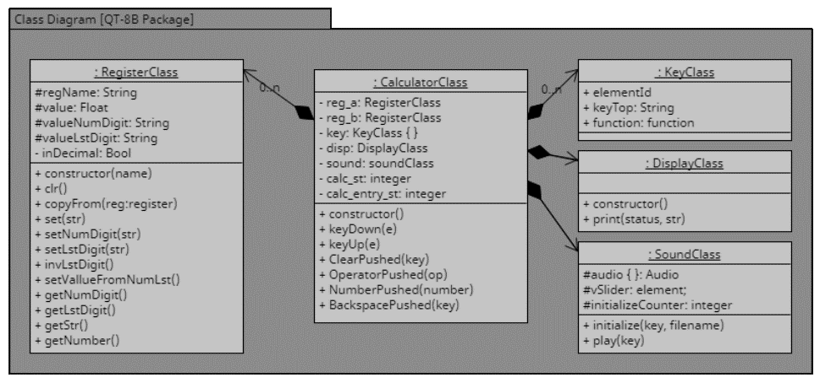
[5] Direction: Simulate It …
On a web page for people to experience
Using modern web technology
JavaScript ES6 (since 2015)
Object-oriented programming is available
CSS3 recent level
Web-Font (since 2010), transform, perspective, text-shadow (since 2019)
Apply object-oriented programming
Object class corresponding to real-world concept
HTML | 60 Lines
CSS | 150 Lines
JavaScript | 500 Lines
Total | 710 Lines
Calculator | Key | Sound
 | Display | Register a, b
Notes:
[05:39-06:17] len=00:38
And finally, simulation directions.
[[ First one, available on the web page ]]
I wrote a code, mainly JavaScript
In total, 700 lines.
With this, I used modern web technology
Such as JavaScript ES6,
CSS3 recent level
And I applied object-oriented programming,
There are object name
[[ calculator, key, display, sound, register a,b, ]]
which correspond to the real-world concept.

Slide 12
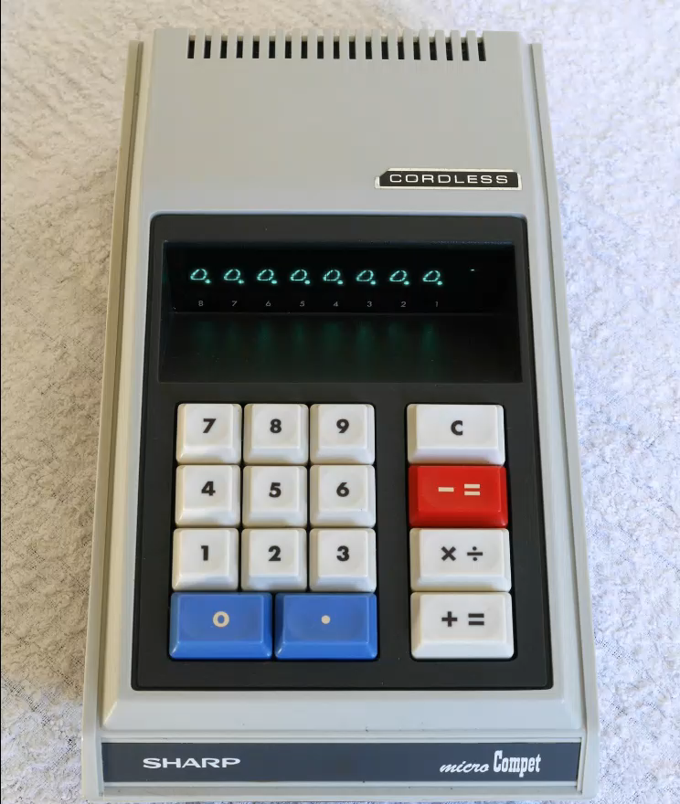
Now, Simulator For World’s Classic Calculator Is Here
Video Operation
Expression | Mouse
1+2 = 3 | 1[+=] 2[+=]
×4 = 12 | [×÷] 4[+=]
÷24=0.5 | [×÷]24[−=]
PC keyboard
3.1415929
6
QT-8B Simulator ⬇(video 25sec)
You Can Try
It by Yourself
QT-8B Real Photo⬇
https://bit.ly/fujiwat-qt-8b
Notes:
[06:19-07:10] len=00:51
Okay,
Now, you can see the simulator.
The left side is the picture. Right side is the simulator.
[ENTER}
(after the video)
[[ Actually,
I added one extra function which is backspace.
It is available only on the PC keyboard.
It is for my test.
I can correct the wrong typing easily by this. ]]

Slide 13
The Results
Difficulty: easy■■□□□□hard
Item | Difficulty | Achieved
[1] Use a real photograph | – | –
Get approval to use | ■■ | 100%
3D perspective | ■■■■ | 100%
[2] Simulate the display, look and feel | – | –
Font design | ■■ | 100%
Using web font | ■■ | 100%
Illuminate the numbers | ■■■■■■ | 80%
[3] Simulate the old era operations | – | –
Operation key: [－=] [×÷] [＋=] | ■■■■■■ | 90%
[4] Simulate the feel of the buttons | – | –
Mechanical Sound | ■■ | 100%
Imitate the shadow of a finger | ■■■■ | 100%
[5] Direction: Simulate it | – | –
On a web page | ■■■■ | 100%
Using modern technology | ■■■■ | 100%
Apply object-oriented programming | ■■■■ | 100%
Already at a similar level when looked at normally.
But precisely to say, it is different…
QT-8B has a function of fixed-point display for decimal fraction (without division result).
Need to investigate more
Notes:
[07:12-07:53] len=00:41
Finally,
I will share my achieved level.
There are 2 items with difficulty hard.
[[ The pink lines. ]]
1st one is illuminate the numbers.
I think it is already at a similar level when
Looked at normally.
But precisely to say, it is different.
The reason is:
there is no illuminate attribute,
[[ therefore, I need to create the similar behavior. ]]
Next one is operation keys.
Normal calculation is okay
but QT-8B has a function of fixed-point display
[[ for decimal fraction without division result. ]]
I need to investigate more.

Slide 14

Thank You for Your Kind Attention
“I took my version from the cabinet to compare. The behavior as well as the looks very well resemble the real machine. ”
– Tiny Henst, owner of QT-8B. from the Netherlands, 30th October 2023.
I received message.➔
I was very encouraged with it.
You can try QT-8B➔
Notes:
[07:55-08:16] len=00:21
I received a message, from an owner of QT-8B, in the Netherlands.
“I took my version from the cabinet to compare.
The behavior as well as the looks
Very well resemble the real machine.
It was very encouraging.
Thank you for your kind attention

